Slide 1
New Anime
A look at where we should go for new content

Slide 2
Where are the best places to look?
Sources of anime
Genres of anime

Slide 3
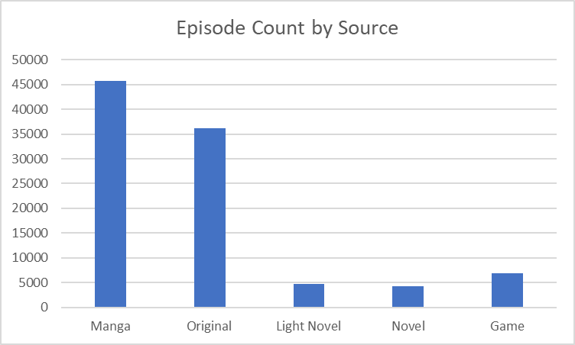
Sources of anime
Manga
Original
Novels
Light Novels
Games

Slide 4
What is our source
Since we know our 2 main sources for Anime are Manga Adaptations, and Original Content, we can to look to Manga that has not been treated yet. Longer running Manga series will give further source materials for a longer running new Anime series.

Slide 5
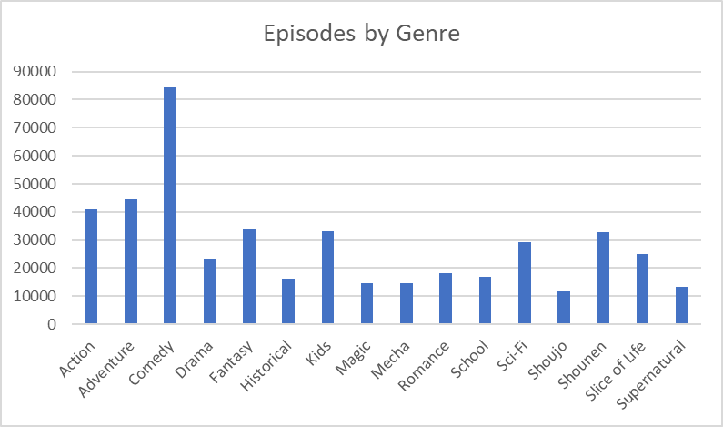
Genres of anime
Action
Adventure
Comedy
Fantasy
Kids

Slide 6
What genres do we use
We know the Top 5 Genres are Action, Adventure, Comedy, Fantasy, and Kids.
There is a statistical, direct correlation between the number to episodes and the ranking and score of an Anime series.
Now we have a focus on where to look for source materials.

Slide 7
Conclusions
We now have our source materials being Manga since Mangas are already in the main stream which makes adaptation easier. The longer running the Manga series, the more source materials we have.
We know the Genres that are the most well received are Action, Adventure, and Comedy.
Now we just need to find the best Manga that holds fits both the source material and the genres.

Slide 8
Thank you, any questions?

